Slide 1
Section 6.3 Calculating Probabilities

Slide 2
Probabilities of Independent Events:
When two events are “independent” they do not affect each other
The probability of two independent events occurring will be equal to the product of the probability of each event
Ie: Suppose the probability of rolling a 2 is 1/6 and flipping a tails is ½.
Then the probability of both events in happening is
H
T

Slide 3
One way to understand this problem is to draw a tree diagram
1st Die
1
2
3
4
5
6
H
T
H
T
H
T
H
T
H
T
H
T

Slide 4
Ex: A spinner is spun and then a die is rolled. What is the probability of getting an even spin and rolling an odd number?
b) What is the probability that the product is even?
Spinner
Even: 2,4
Odd: 1,3
You have one in four chance of spinning an even number &
then rolling an odd number
2,4,6
1,3,5
2,4,6
Answer for “b” is on the next page!
1,3,5

Slide 5
Note: Tree diagrams can be used for calculating probabilities when two events affect each other (Dependent Events)
For instance, if the spinner hits an odd number, the dice must roll an even number to get an even product
However, if the spinner hits an even number, the dice can roll any number and the product will still be even
To calculate the probability of getting an even product, we need to add all the cases together
Spinner
Even: 2,4
Odd: 1,3
You have a probability of 3 out of every 4 chance of getting an even product
1,3,5
2,4,6
1,3,5
2,4,6

Slide 6
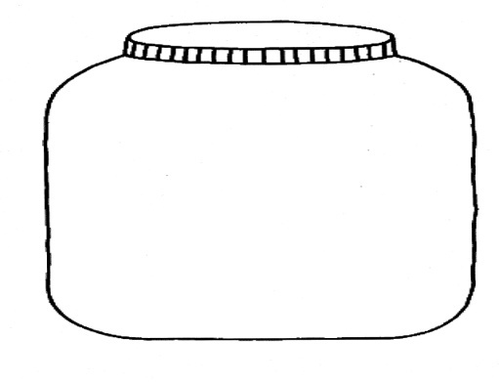
Ex: Andy and Betty will each take a marble from Jars A and B respectively.
a) What is the sample space of this event?
b) What is the probability of P(Green, Green)?
Jar A
Jar B
Sample Space:
Jar A
P(Green, Green)
Red
Green
1 out of every 5 attempts will yield a green marble followed by another green marble
Blue
Green
Blue
Green

Slide 7
Practice: Andy and Betty will each take a marble from Jars A and B respectively.
a) What is the sample space of this event?
b) What is the probability of P(Red, Blue)?
Jar A
Jar B
Sample Space:
Jar A
P(Red, Blue)
Red
Green
2 out of every 9 attempts will yield a red marble followed by a blue marble
Red
Blue
Green
Red
Blue
Green

Slide 8
Homework:
P432 #4 to 16

